Slide 1
Excel Ninja Shortcuts
Version: 05-Apr-2018

Slide 2
Range Navigation & Selection
Folder M 01 > Filename “1A Essential Shortcuts.xlsx” > Sheet1
Choose the Yellow cell

Slide 3
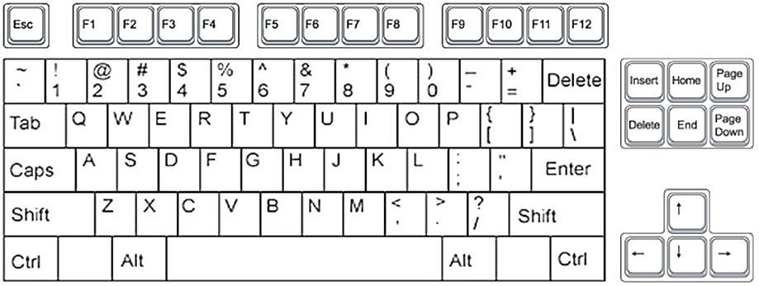
Ctrl + Arrow Keys: Range Navigation

Slide 4
Ctrl + Shift + Arrow Keys: Range Selection

Slide 5
Ctrl + Shift + End: Select [active cell to the last used cell]
[Helps skip all the blank rows]

Slide 6
Ctrl + Backspace: Go to header with selection intact
Back
Space

Slide 7
Ctrl + Spacebar: Selects entire column

Slide 8
Shift + Spacebar: Selects entire row

Slide 9
Insert / Delete Rows & Columns

Slide 10
Ctrl + Minus: Deletes

Slide 11
Ctrl + Shift + Plus: Inserts

Slide 12
Formula Auditing Tricks

Slide 13
Ctrl ` to Show all formulas

Slide 14
Date
Folder M 01 > Filename “1A Essential Shortcuts.xlsx” > Sheet2
Choose the Yellow cell

Slide 15
Ctrl + ; to enter today’s date

Slide 16
Ctrl + Shift + 3 to apply date format (dd-mmm-yy)

Slide 17
User defined Shortcuts

Slide 18
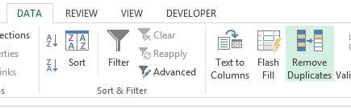
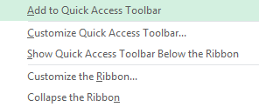
Add buttons to QAT & then using ALT key for shortcuts

Slide 19
End

